Slide 1
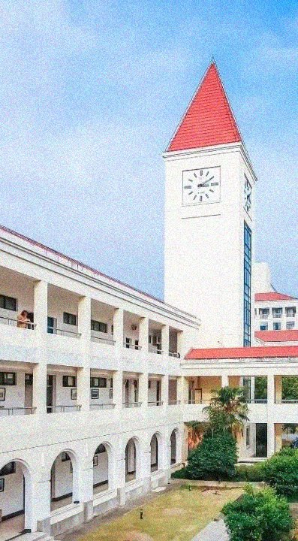
Omni-Kernel Network for Image Restoration
Reporter: Yilin Chen
The College of Information, Mechanical and Electrical Engineering, Shanghai Normal University, Shanghai, China
Email: chenyilin0126@126.com
19th, November, 2024

Slide 2
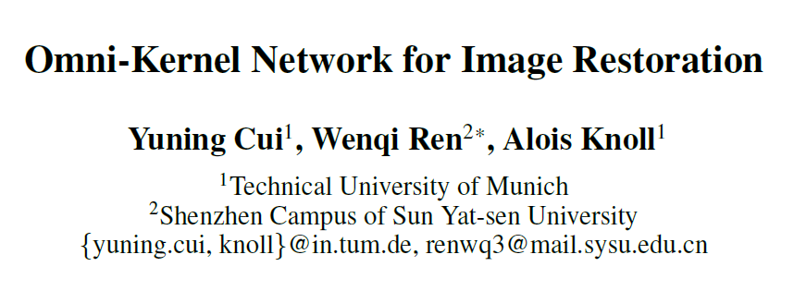
Title & Authors
Omni
n.
全能的；
座席；
【医】全，全部
Start with thinking:
What is Omni-Kernel Network?
How does it work? Where does its advantages lie in?

Slide 3
Abstract
Image restoration aims to reconstruct a high-quality image from a degraded low-quality observation. Recently, Transformer models have achieved promising performance on image restoration tasks due to their powerful ability to model long-range dependencies. However, the quadratically growing complexity with respect to the input size makes them inapplicable to practical applications. In this paper, we develop an efficient convolutional network for image restoration by enhancing multi-scale representation learning. To this end, we propose an omni-kernel module that consists of three branches, i.e., global, large, and local branches, to learn global-to-local feature representations efficiently.
Notes:
Recent main approaches:
Transformer-based models
The weakness of Transformer:
the quadratically growing complexity
Our alternative methods:
A convolutional network
An omni-kernel module that consists of three branches: global, large, and local branches

Slide 4
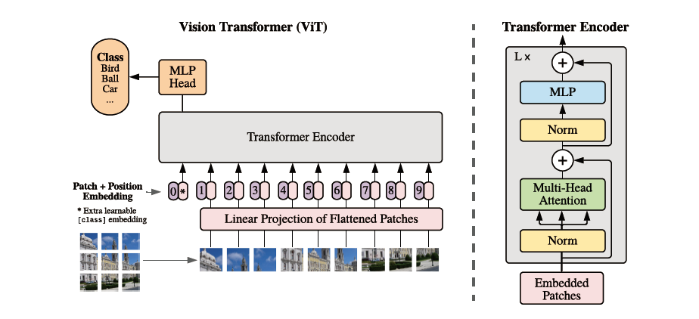
Abstract
d dimension
N patches

Slide 5
Abstract
Specifically, the global branch achieves a global perceptive field via the dual-domain channel attention and frequency-gated mechanism. Furthermore, to provide multi-grained receptive fields, the large branch is formulated via different shapes of depth-wise convolutions with unusually large kernel sizes. Moreover, we complement local information using a point-wise depth-wise convolution. Finally, the proposed network, dubbed OKNet, is established by inserting the omni-kernel module into the bottleneck position for efficiency. Extensive experiments demonstrate that our network achieves state-of-the-art performance on 11 benchmark datasets for three representative image restoration tasks, including image dehazing, image desnowing, and image defocus deblurring. The code is available at https://github.com/c-yn/OKNet.
Notes:
The global branch:
dual-domain channel attention
frequency-gated mechanism
The large branch:
different shapes of depth-wise convolutions with large kernel sizes
The local branch:
a point-wise depth-wise convolution
OKNet

Slide 6
Introduction
Para 1-2
Image restoration aims to restore a sharp image from its low-quality counterpart, which suffers from degradations such as haze, snowflakes, and blur. To deal with this longstanding ill-posed problem, conventional approaches utilized various hand-crafted features and assumptions to restrict solution spaces. However, these methods are not applicable to more challenging real-world scenarios.
In recent years, convolutional neural networks (CNNs) have achieved superior performance over traditional algorithms on image restoration tasks by learning generalizable priors from collected large-scale datasets. To further improve performance, many advanced functional units have been developed or borrowed from other domains for image restoration, such as the encoder-decoder architecture, residual connection, and attention mechanisms.

Slide 7
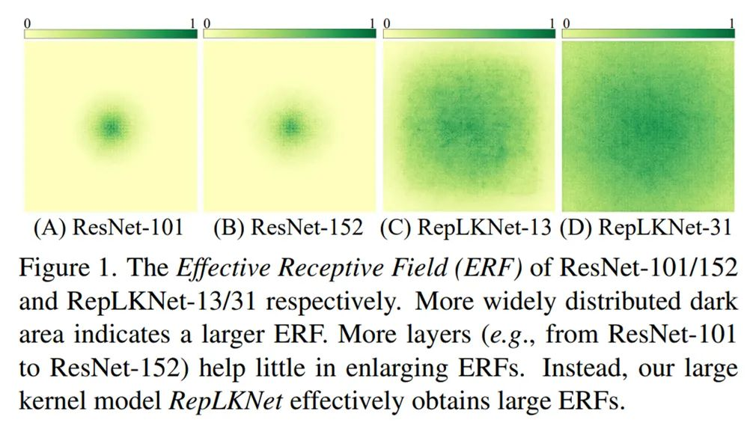
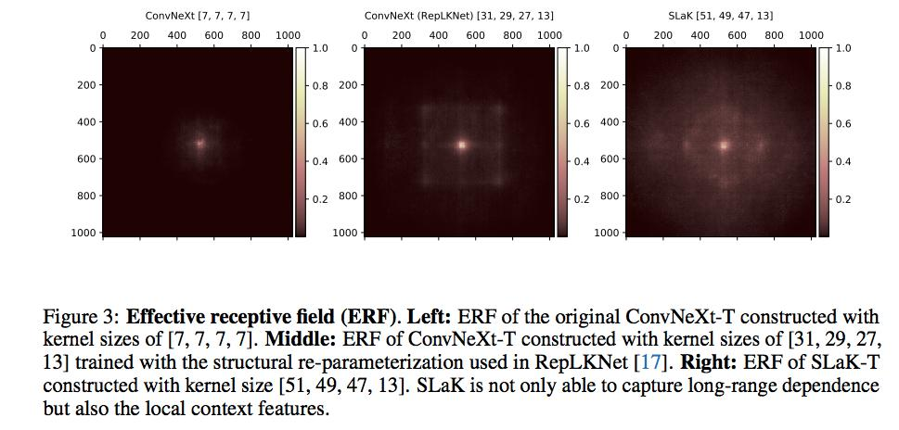
Introduction
Para 2-3
More recently, Transformer models have been introduced into image restoration and significantly advanced the state-of-the-art performance. Nonetheless, the complexity of the core component, self-attention, grows quadratically with respect to the input size, making these methods unsuitable for practical applications.
In contrast to the convolution operator that has limited receptive fields, Transformer models conduct global or large window-based self-attention, enabling networks to obtain large receptive fields. Inspired by this mechanism, a few recent works on CNNs strike back by designing efficient CNN frameworks with large kernels, such as 31×31 in RepLKNet and 51 × 51 in SLaK.

Slide 8
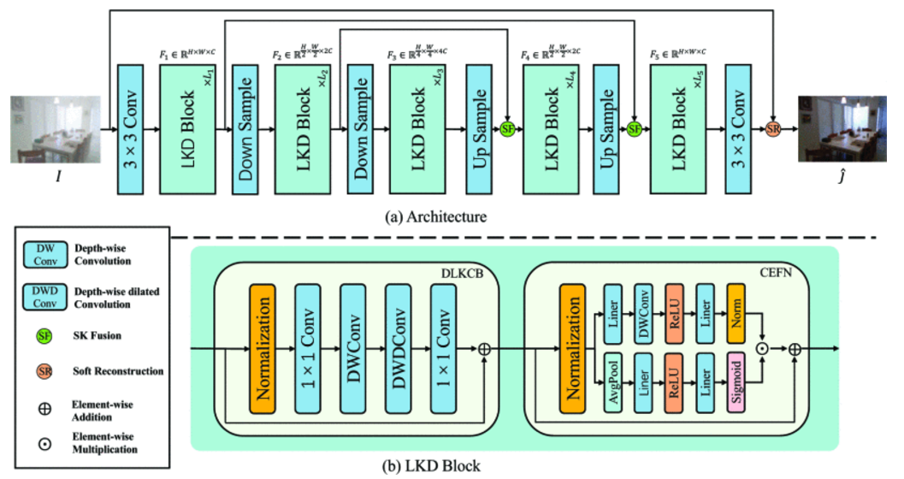
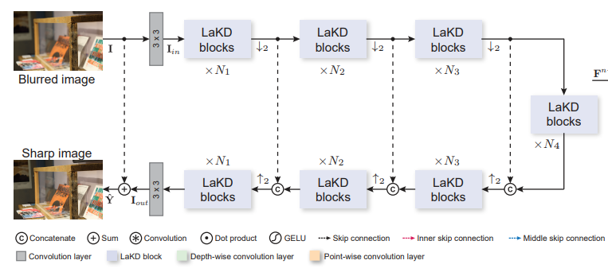
Introduction
Para 3
In the context of image restoration, LKDNet decomposes a 21×21 convolution into a smaller depth-wise convolution and a depth-wise dilated convolution for image dehazing. LaKDNet leverages large kernel size convolutions (e.g., 9 × 9) followed by point-wise convolutions to obtain large effective receptive fields for image deblurring. MAN decomposes a large kernel size convolution into three components, i.e., a depth-wise convolution, a depth-wise dilated convolution, and a point-wise convolution. However, the receptive fields produced by these methods are still limited, and they do not provide global receptive fields.

Slide 9
Introduction
Para 4
In this paper, we explore the potential of unusually large kernel size convolutions for image restoration by using a 63 × 63 depth-wise convolution. Furthermore, we utilize large strip-based convolutions to further enhance representation learning for high-quality image reconstruction. To restrain computation overhead brought by these large convolutions, we deploy them only in the bottleneck. Moreover, we resort to the dual-domain channel attention and frequency-gated mechanism to provide global receptive fields. In addition to pursuing large receptive fields, we also utilize a 1×1 depth-wise convolution to complement local information for small-size degradations. Finally, the proposed omni-kernel module (OKM) is formed by organizing the above designs in parallel such that the network possesses the ability to handle multi-scale degradations.

Slide 10
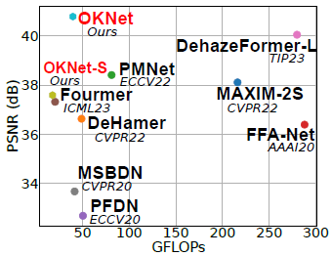
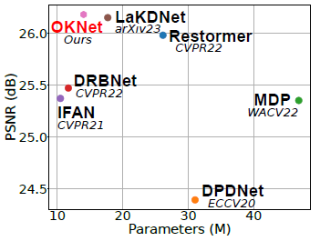
Introduction
Para 5
Equipped with OKM in the bottleneck, our simple convolutional network achieves state-of-the-art performance on 11 different datasets for three representative image restoration tasks. More concretely, OKNet significantly outperforms the recent Transformer model Fourmer by 3.47 dB PSNR with comparable complexity on the SOTS-Indoor dataset, as illustrated in Figure 1 (a). For single-image defocus deblurring, our model achieves a performance gain of 0.2 dB PSNR over the strong Transformer model Restormer in the combined category of the DPDD dataset with 46% fewer parameters. Furthermore, the proposed model also represents the strong capability on the image desnowing task, outperforming the recent algorithm IRNeXt by 0.7 dB PSNR on the CSD dataset.

Slide 11
Introduction
Para 5
Overall, the contributions of this paper can be summarized as follows:
We present an omni-kernel module that is capable of efficiently capturing multi-scale receptive fields for image restoration, among which large-scale information is modulated via the dual-domain processing and different shapes of large kernel size depth-wise convolutions.
Extensive experiments on 11 widely used benchmark datasets demonstrate that the proposed model, namely OKNet, achieves state-of-the-art performance on three representative image restoration tasks, i.e., image defocus deblurring, image dehazing, and image desnowing.

Slide 12
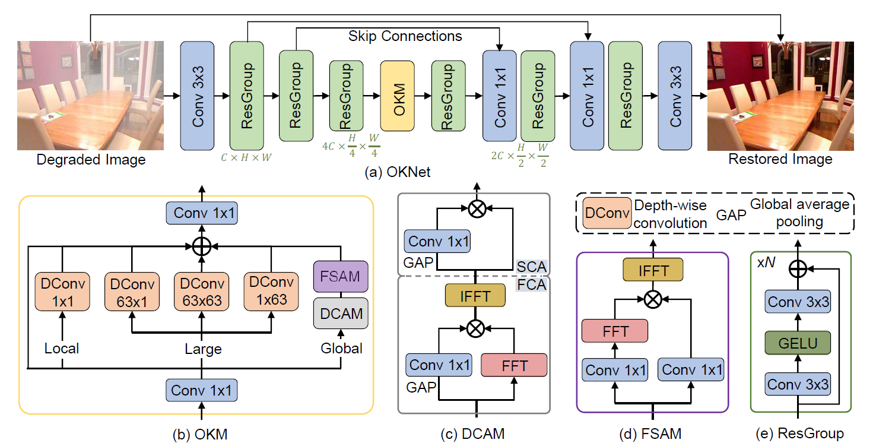
Methodology
Overall Pipeline
Encoder
Bottleneck
Decoder
Three scales in both the encoder and decoder stages.
ResGroup is composed of multiple residual blocks.
OKM is only inserted into the bottleneck position.

Slide 13
Methodology
Overall Pipeline

Slide 14
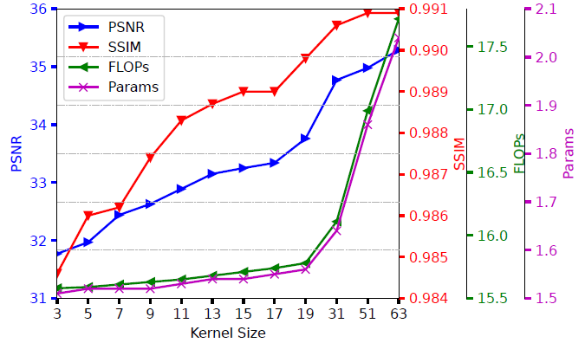
Methodology
Omni-Kernel Module (OKM)
The selection of K

Slide 15
Methodology
Loss Function

Slide 16
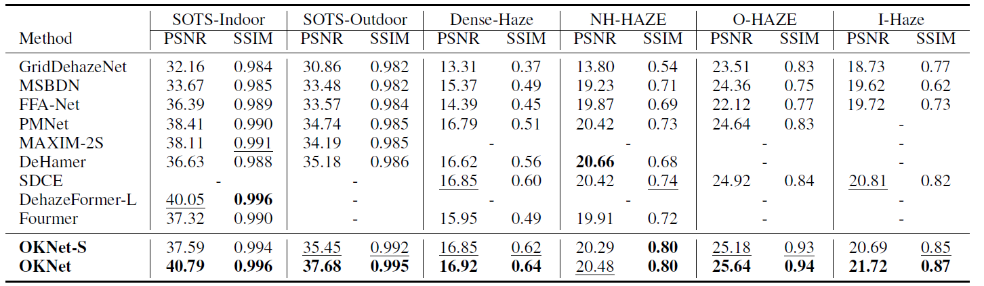
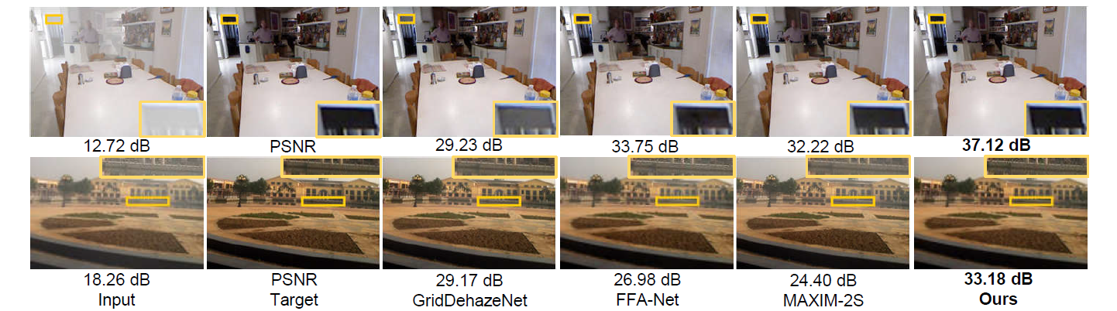
Experiments
Results (Image dehazing)

Slide 17
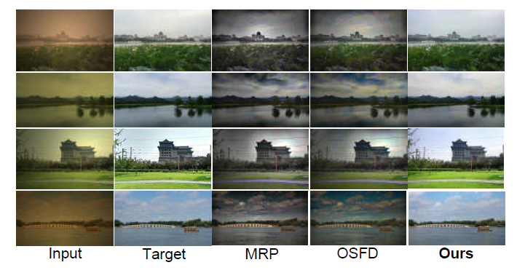
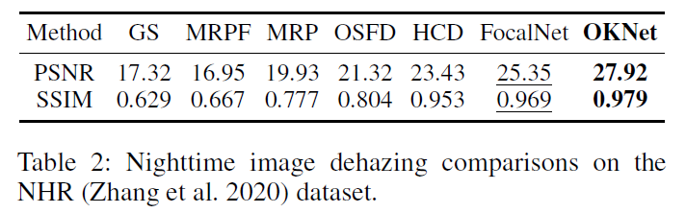
Experiments
Results (Image dehazing)

Slide 18
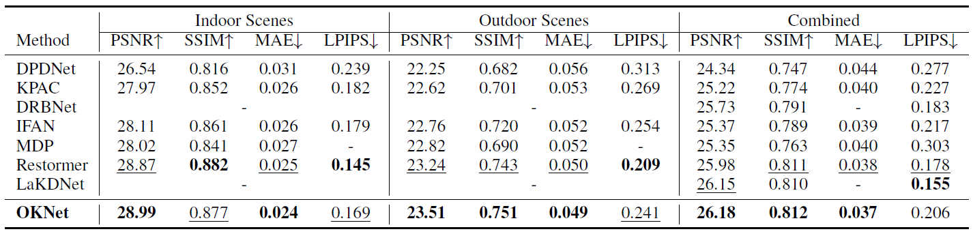
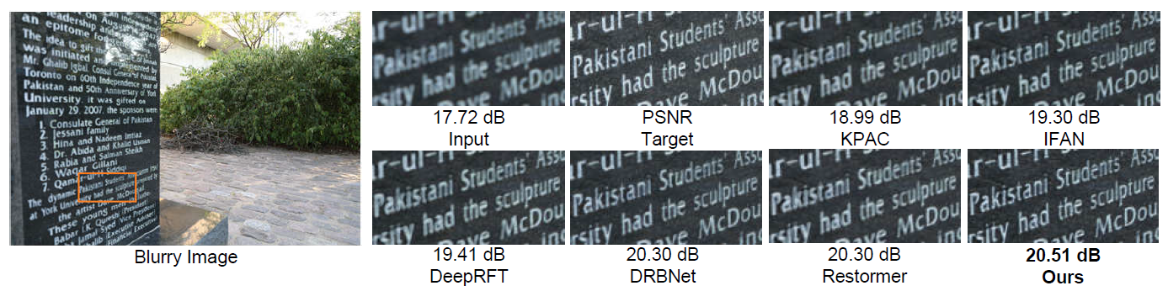
Experiments
Results (Image deblurring)

Slide 19
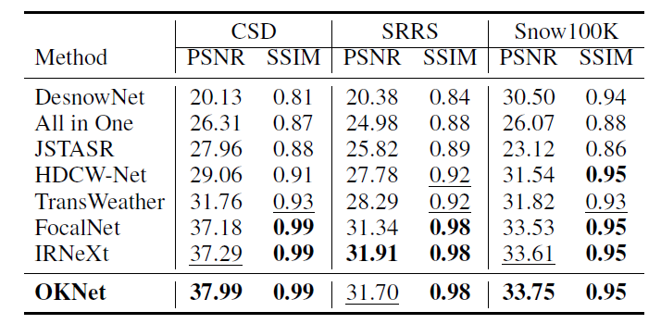
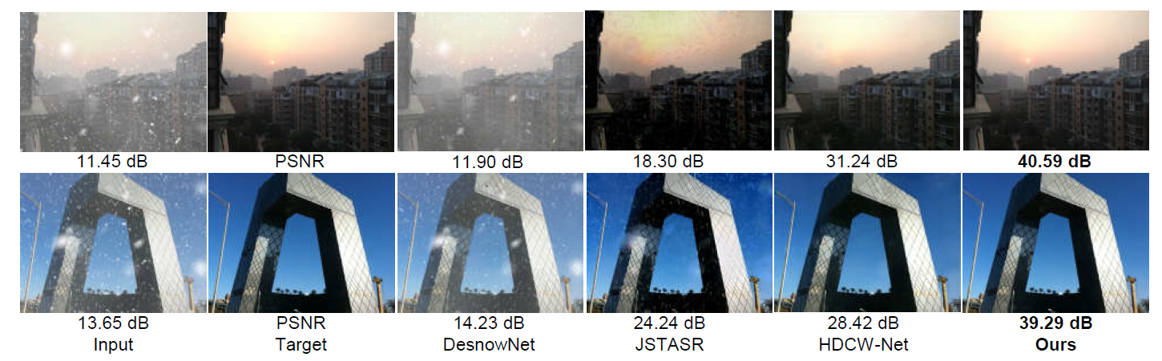
Experiments
Results (Image desnowing)

Slide 20
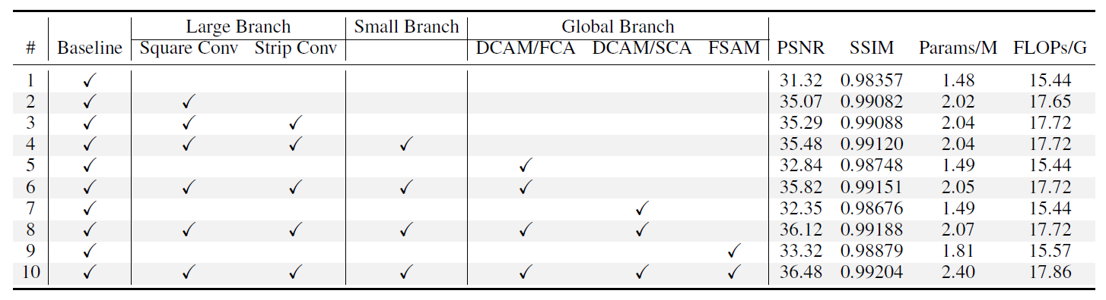
Experiments
Ablation Studies
Using OKNet-S
Training on the RESIDE-Indoor dataset for 300 epochs
Evaluating on SOTS-Indoor

Slide 21
Conclusion
In this paper, we propose an efficient convolutional network, dubbed OKNet, which is capable of capturing multi-scale receptive fields. The core component, OKM, consists of three branches for modeling local, large, and global dependencies. The large branch is designed by exploring the unusually large regular and strip-based depth-wise convolutions for image restoration. The novel global branch utilizes dual-domain channel attention and frequency-based spatial attention for modulating global representations. Furthermore, the extremely lightweight local branch brings locality to the model. Inserting the simple yet effective OKM into the bottleneck, OKNet achieves state-of-the-art performance on 11 different datasets for three image restoration tasks.
Notes:
OKM:
consists of three branches for modeling local, large, and global dependencies
The large branch:
large regular and strip-based depth-wise convolutions
The global branch:
dual-domain channel attention
frequency-based spatial attention

Slide 22
Thanks for listening!
Omni-Kernel Network for Image Restoration
Reporter: Yilin Chen
The College of Information, Mechanical and Electrical Engineering, Shanghai Normal University, Shanghai, China
Email: chenyilin0126@126.com
19th, November, 2024

