Slide 1
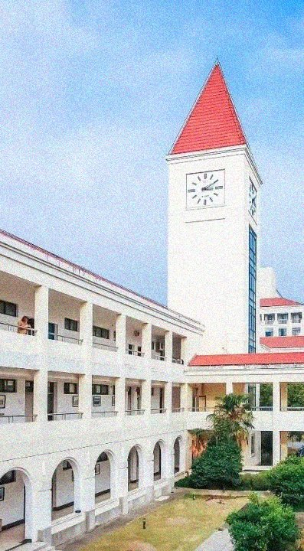
Residual Deformable Convolution for better image de-weathering
Reporter: Yilin Chen
The College of Information, Mechanical and Electrical Engineering, Shanghai Normal University, Shanghai, China
Email: chenyilin0126@126.com
24th, December, 2024

Slide 2
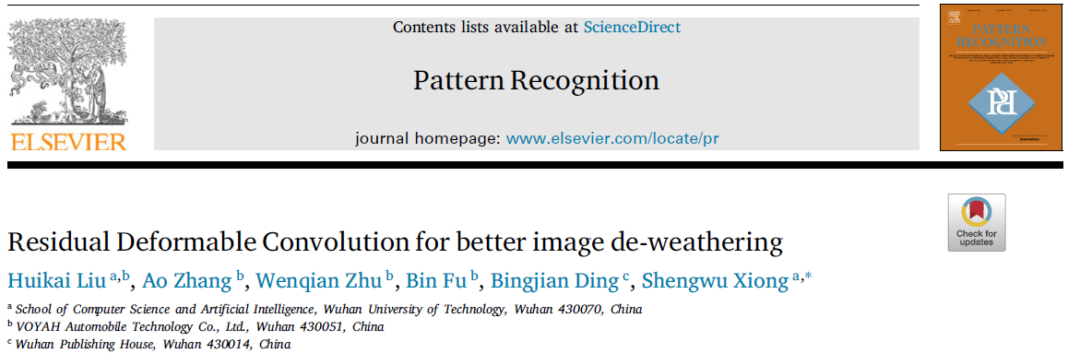
Title & Authors

Slide 3
Abstract
Adverse weather conditions pose great challenges to computer vision tasks like detection, segmentation, tracing et, al. in the wild. Image de-weathering aiming at removing weather degradations from images/videos has hence accumulated huge popularity as a significant component of image restoration. A large number of SOTA de-weathering methods are based on the autoencoder architecture for its excellent generalization and high computational efficiency. However, for most of these models, parts of high-frequency information are inevitably lost in the down-sampling process in the encoders, while degraded features are unable to be effectively inhibited in the up-sampling modules in the decoders, largely limiting the restoration performance.
Notes:
Down-sampling process:
Loss of high-frequency information
Up-sampling modules:
Degraded features are unable to be effectively inhibited

Slide 4
Abstract
In this paper, we propose a multi-path skip-forward structure for the encoder to deliver fine-grain features from shallow layers to deep layers, and provide more detailed semantics for feature embedding. For the decoding part, the Residual Deformable Convolutional module is developed to dynamically recover the degradation with spatial attention, achieving high-quality pixel-wise reconstruction. Extensive experiments show that our model outperforms many recently proposed state-of-the-art works on both specific-task de-weathering, such as de-raining, de-snowing, and all-task de-weathering. The source code is available at https://github.com/IntelligentDrivingCoding/DeformDeweatherNet.
Notes:
Our proposed methods:
a multi-path skip-forward structure (Encoder)
Residual Deformable Convolutional module
(Decoder)

Slide 5
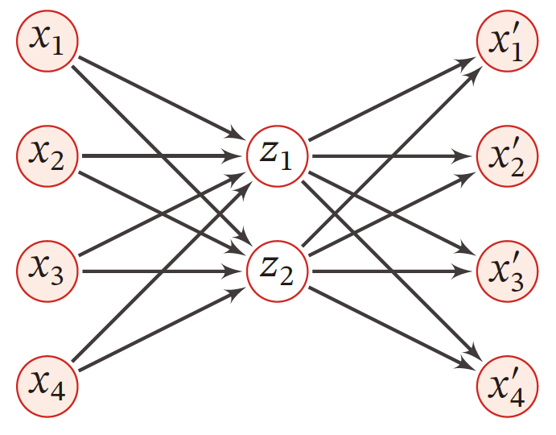
Introduction
AE-based methods
Encoder
Decoder

Slide 6
Introduction
Three main limitations of AE-based methods
First, the encoding process of most modern AEs is a sing-forward process, leading that the high-frequency information with low semantics is easily lost or overwhelmed with the reduction of the feature maps resolution.
Second, Convolutional Neural Networks (CNN) based decoders use fixed-geometric filters for image recovery and cannot selectively identify the non-degraded neighborhood areas of the targeted degraded ones, limiting the restoration quality.
Lastly, the long-range dependencies aware filters such as large-kernel CNNs and MSA modules, which are helpful for improving the restoration with more computation consumption, are difficult to balance between efficiency and accuracy.

Slide 7
Introduction
Solutions
To handle these problems, we propose a multi-path skip-forward structure that allows multi-grain visual information from shallow features to be directly delivered to deep ones to solve the first problem. Specifically, the RePatch layers act on the input image with multiple down-sample ratios for multi-grain feature learning, and the learned features are then fused with different output features in each stage.
For the other two problems, we propose an efficient decoder with moderate kernel size to reduce the computation complexity and introduce spatial attention to selectively up-sample semantic features with less degradation. The spatial attention is realized simply by two successive deformable convolutions but obviously promotes the image recovery results.

Slide 8
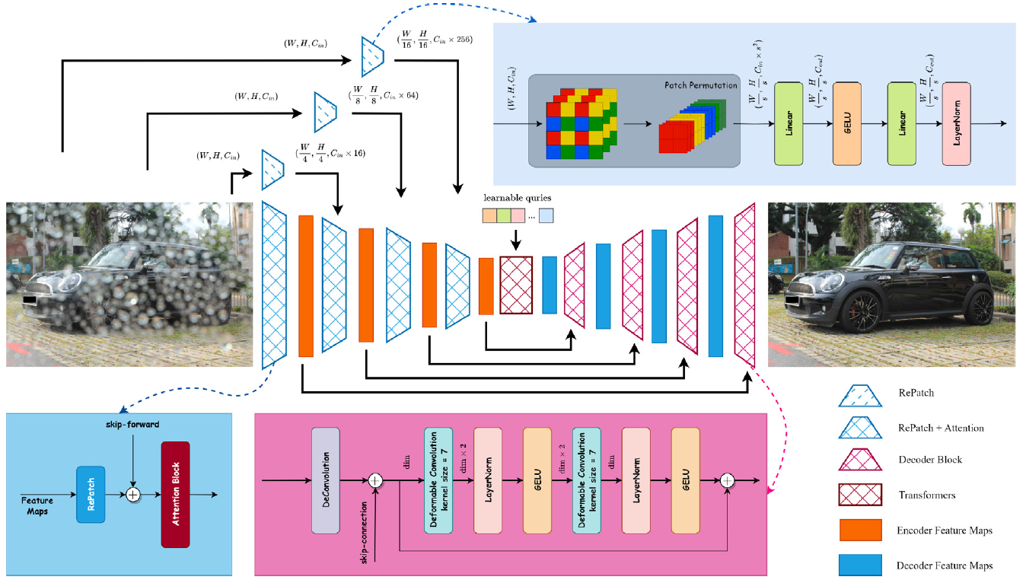
Methodology
Overall Pipeline
RePatch
Multi-path skip-forward
Residual deformable convolutional networks

Slide 9
Methodology
Overall Pipeline
RePatch
Multi-path skip-forward
Residual deformable convolutional networks

Slide 10
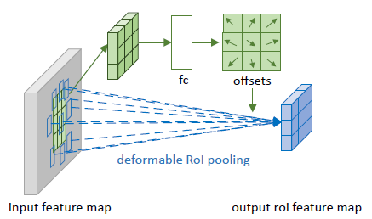
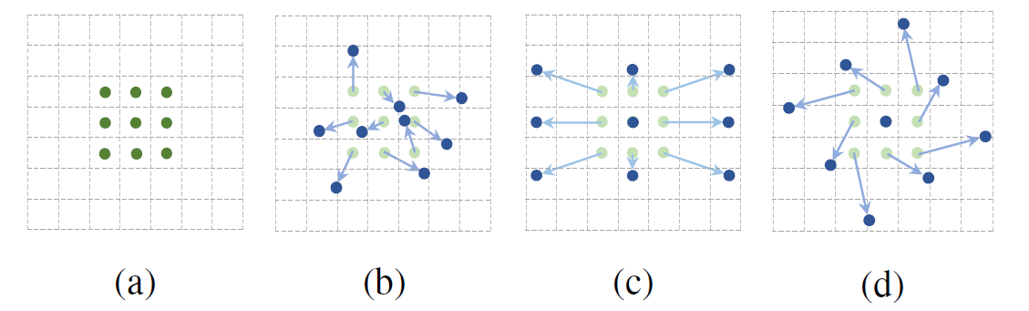
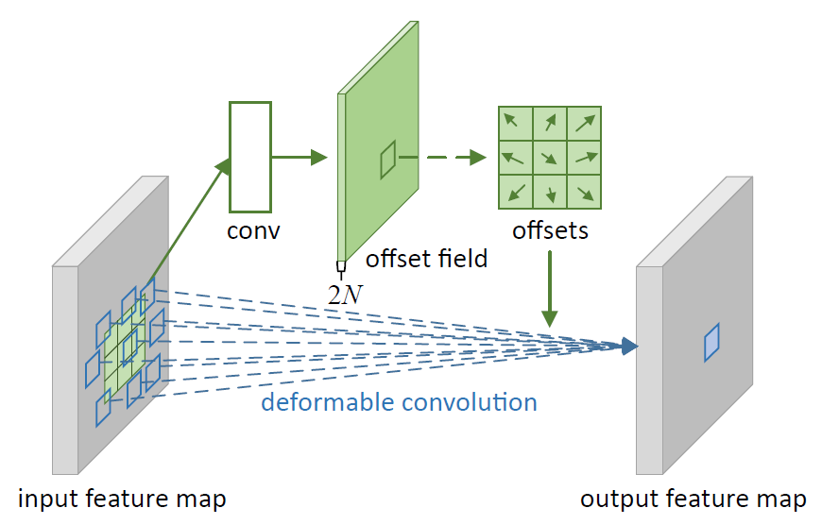
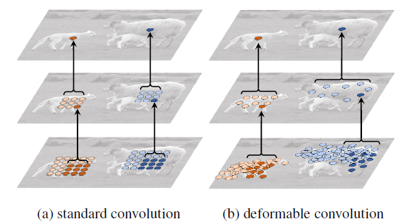
Methodology
Deformable Convolution
Dai J , Qi H , Xiong Y ,et al. Deformable Convolutional Networks[C]//IEEE.IEEE, 2017.DOI:10.1109/ICCV.2017.89.

Slide 11
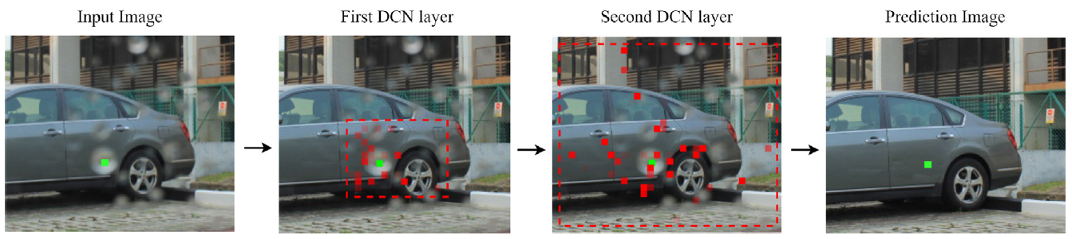
Methodology
Deformable Convolution
Given an activation unit (green points), the visualization of the sampling locations of different DCN layers in an encoder stage. From left to right: input image, sampling locations in the first DCN layer, sampling locations in the second DCN layer, restored image. The relationship between the activation unit and the sampling locations is shown in the two middle figures. As the DCN layers go deeper, sampling locations distribute with a larger field of view and larger offsets. (For interpretation of the references to color in this figure legend, the reader is referred to the web version of this article.)

Slide 12
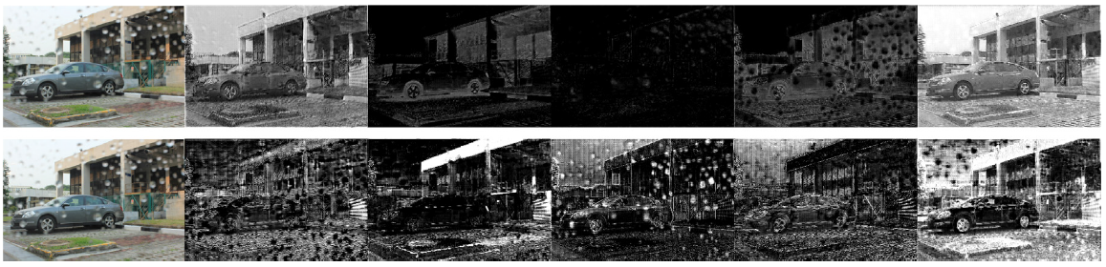
Methodology
Deformable Convolution
Comparison between the Residual Deformable Convolutional block and the Residual block, represented by the first and second row, respectively. The left column is the input image; the other columns are the feature maps from the last encoder stage.

Slide 13
Methodology
Loss Function

Slide 14
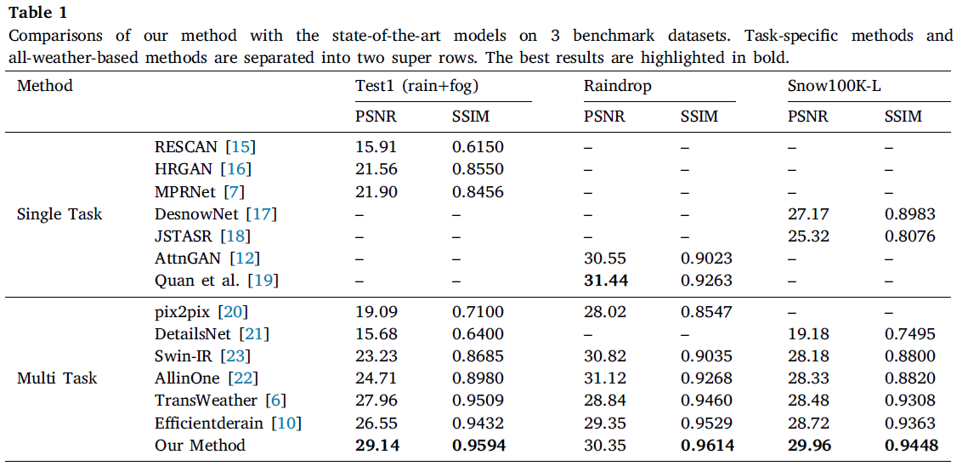
Experiments
Results

Slide 15
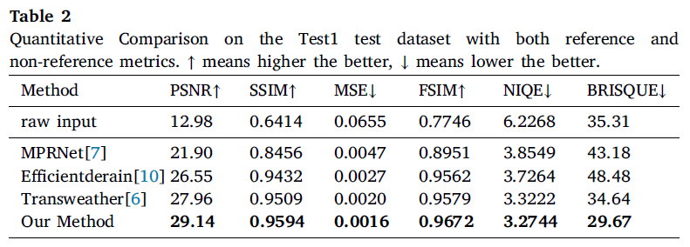
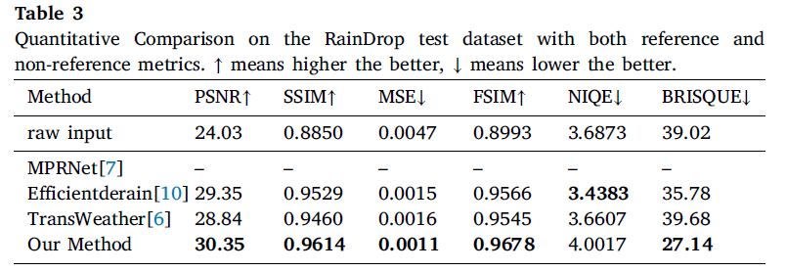
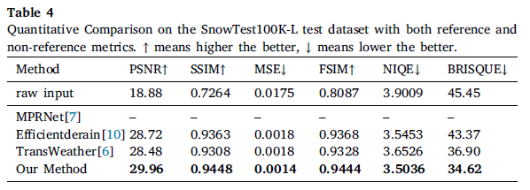
Experiments
Results

Slide 16
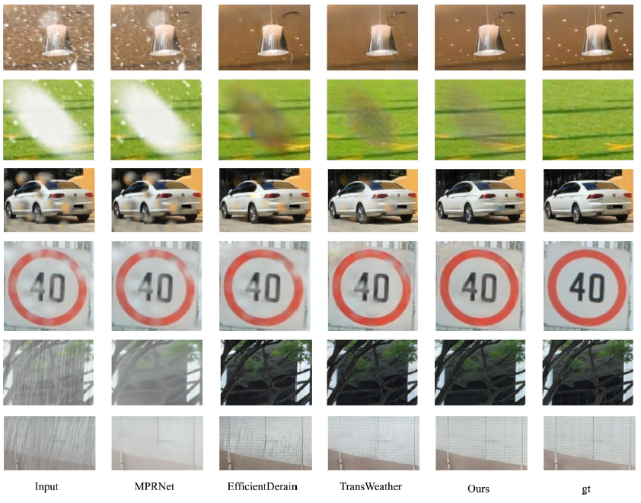
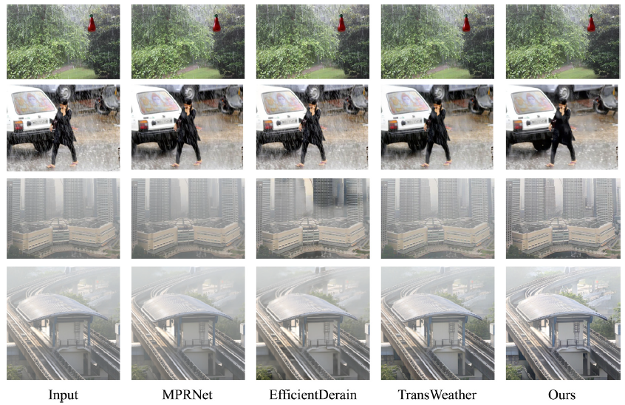
Experiments
Results

Slide 17
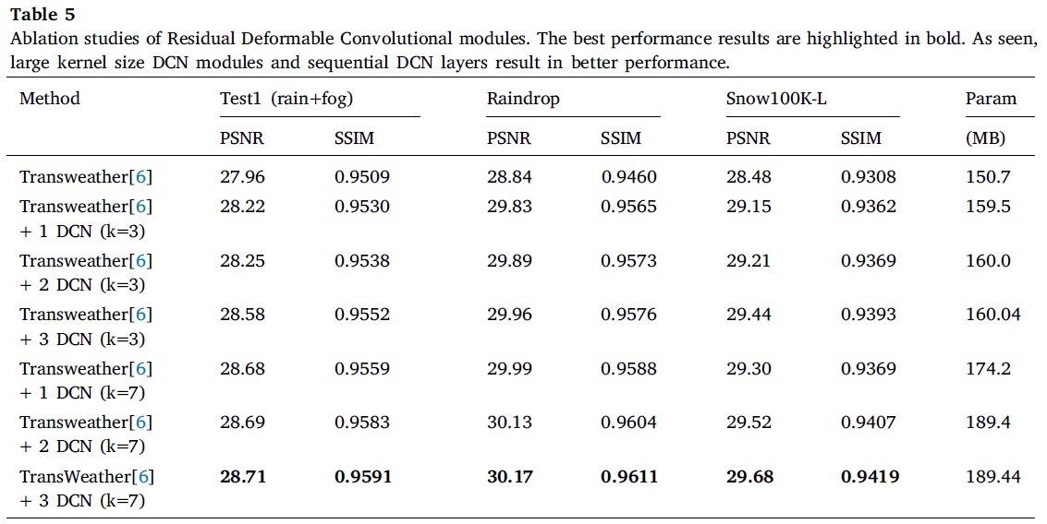
Experiments
Ablation Studies

Slide 18
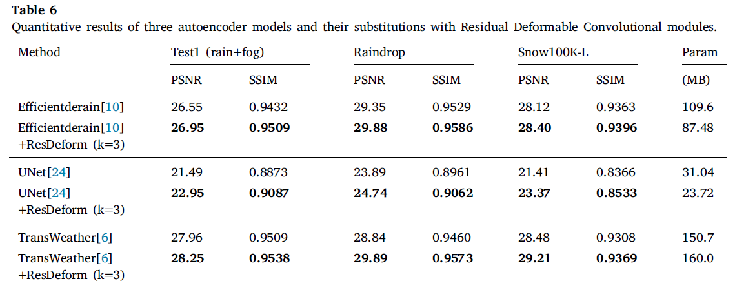
Experiments
Ablation Studies

Slide 19
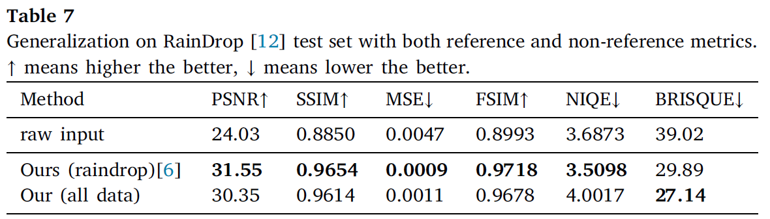
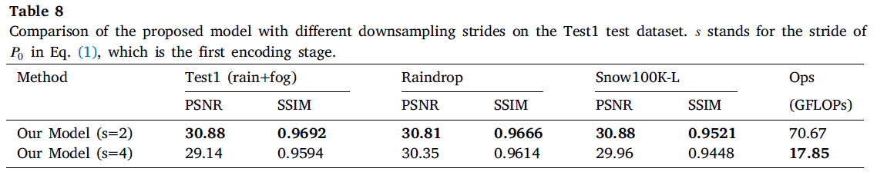
Experiments
Limitation and future work
First, the model is not able to generalize well on different datasets.
In addition, we find that the choice of down-sampling ratios in the encoding stages limits the model performance.

Slide 20
Conclusion
In this work, we present an efficient all-task de-weathering model using a simple AE architecture. We develop two novel core components in the encoder and decoder respectively to improve feature representation and enhance image reconstruction. For the encoder, we first introduce convolutional attention for local shallow feature learning and then adopt MSA on the refined feature to capture the global range dependencies, formulating the main feature learning path that realizes excellent feature representation with limited computational complexity. Additionally, we introduce an extended patch merger (named RePatch) that down-samples features in a token fusion way to extract multi-grain features from multiple paths, including those from the original input images and the main feature learning path. The multiple paths from the input with different RePatch layers preserve detailed semantics and high-frequency information, refining the feature learning process in the encoder through skip connections.
Notes:
Encoder:
convolutional attention + MSA
an extended patch merger (named RePatch)
Decoder:
the Residual Deformable Convolutional (ResDeform) modules
Limitations:
greater computation consumption of MSA
the generalization of the model

Slide 21
Conclusion
For the decoder, we introduce the Residual Deformable Convolutional (ResDeform) modules. These modules employ semantic-based deformable sample strategies with multiple respective fields to dynamically up-sample features and selectively embedding surrounding contexts. The ResDeform modules effectively add spatial awareness to the decoder, enhancing valuable visual information while suppressing the weather noise for degraded regions’ reconstruction. Furthermore, additional subjective and objective experiments are conducted to demonstrate that the ResDeform modules can perfectly cooperate with many other AE-based models and achieve better de-weathering performance with limited additional computational consumption. Extensive experiments on three de-weathering benchmark datasets and some other real-world datasets demonstrate our proposed model handles very well on all-task image de-weathering, both effectively and efficiently.
Notes:
Encoder:
convolutional attention + MSA
an extended patch merger (named RePatch)
Decoder:
the Residual Deformable Convolutional (ResDeform) modules
Limitations:
greater computation consumption of MSA
the generalization of the model

Slide 22
Conclusion
Despite the outstanding contributions on the all-task image de-weathering made by our work, there are still some limitations that have not yet been well addressed. First of all, the MSA that captures long-range dependencies in the encoder contributes a lot to feature representation but entails greater computation consumption. Especially, we find in experiments that 𝐏_{𝟎} with small strides bring better de-weathering performance and of course much higher computational complexity due to the following MSA modules. This gap between performance and efficiency prevents our model from realizing more ideal de-weathering and we are working on the problem by developing a dynamic window-based MSA mechanism where dependencies of different ranges are calculated within adaptively constructed windows.
Notes:
Encoder:
convolutional attention + MSA
an extended patch merger (named RePatch)
Decoder:
the Residual Deformable Convolutional (ResDeform) modules
Limitations:
greater computation consumption of MSA
the generalization of the model

Slide 23
Conclusion
Another shortcoming of the proposed model lies in its generalization, as it heavily relies on the training dataset. This is also a key issue that makes it difficult to apply the supervised image de-weathering models in real-world applications. To improve the issue, we are studying the data distribution characteristics of different weather noises using a CycleGan-based model, constructing a preliminary weather noises generator to get label image pairs in a semi-supervised way with little cost.
Notes:
Encoder:
convolutional attention + MSA
an extended patch merger (named RePatch)
Decoder:
the Residual Deformable Convolutional (ResDeform) modules
Limitations:
greater computation consumption of MSA
the generalization of the model

Slide 24
Thanks for listening!
Residual Deformable Convolution for better image de-weathering
Reporter: Yilin Chen
The College of Information, Mechanical and Electrical Engineering, Shanghai Normal University, Shanghai, China
Email: chenyilin0126@126.com
24th, December, 2024

