Slide 1
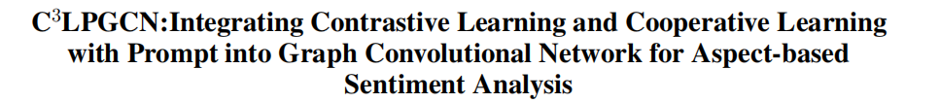
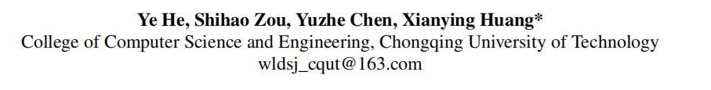

Slide 2
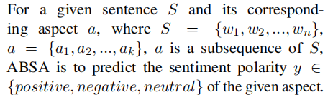
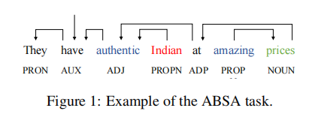
Aspect-based Sentiment Analysis
I bought a new camera. The picture quality is amazing but the battery life is too short.

Slide 3
Challenges
when the syntactic structure of sentences is incomplete or there is no apparent syntactic relationship between aspects and sentiments, syntactic parser may output incorrect syntactic dependency adjacency matrices, thereby leading to noise in the modeling of syntactic information.
How to make better use of comparative learning and labeling information

Slide 4
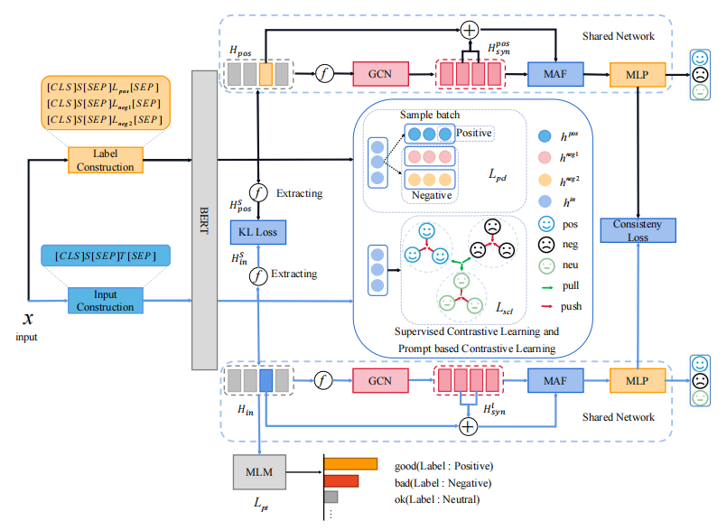
C3LPGCN

Slide 5
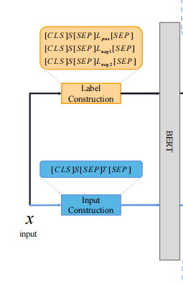


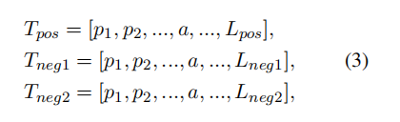


No disk is included
The disk is MASK

Slide 6

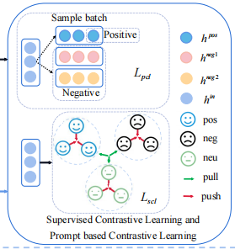
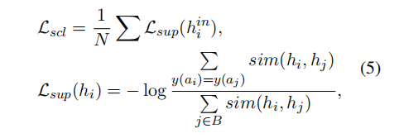
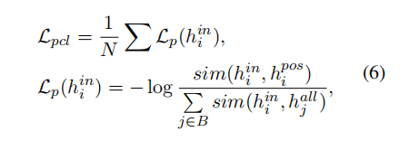
Contrastive Learning
The disk is POS
The disk is NEU
The disk is NEG

Slide 7


Slide 8
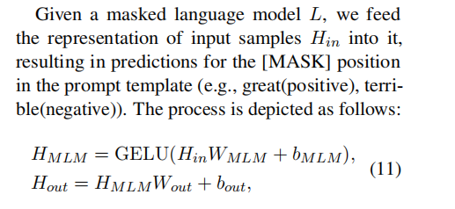
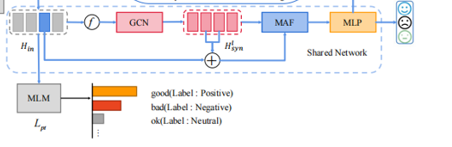
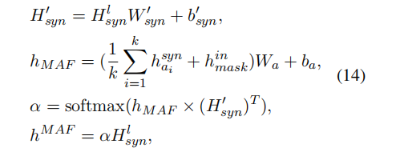

Mask-aware Aspect Information filter

Slide 9


Target Aspect Sentiment Analysis

Slide 10
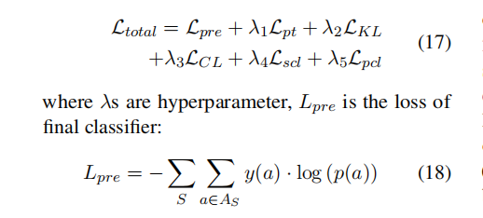
Loss Function

Slide 11
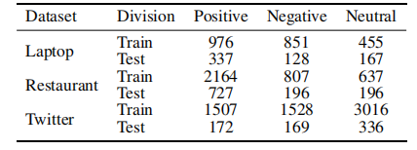
Datasets

Slide 12
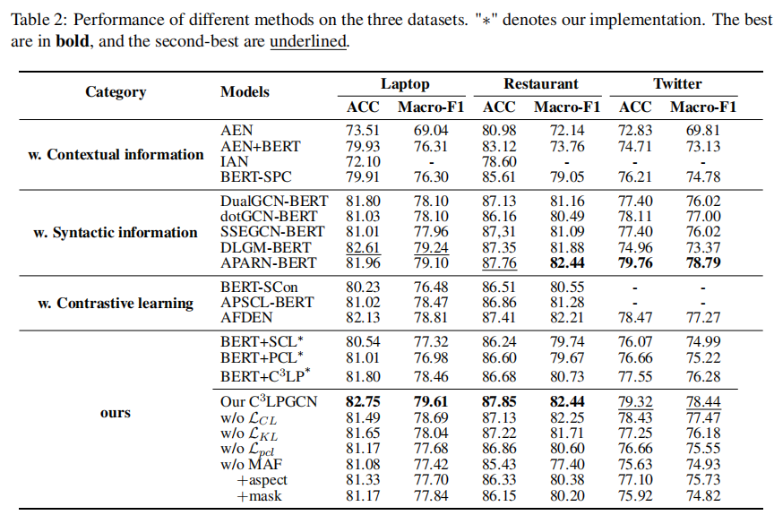
Results

